Slide 1
Range Trading Team 4
Chris Walter, Cameron Nguyen, Adi Kohli

Slide 2
Overview
Introduction
Aim to create a range trading strategy that entails the most profit
Purpose of this presentation is to see how a combination of indicators can be used instead of single ones
The strategy we are proposing uses a simple approach that consists of combining two indicators
Initially investigated using three to four indicators but found that it was ineffective

Slide 3
Indicators
RSI
A definitive RSI range for the strategy is derived from statistical inference to define conditions for entering trades.
MAC D
A moving average convergence/divergence indicator
Bollinger Bands
Lagging indicator that is shows price two standard deviations above and below a trailing mean of the current share price. Useful to indicate recent volatility of share price.

Slide 4
RSI
Purpose
Using trial and error a range of 40 – 60 for the RSI was discovered where the optimal RSI is greater than 40
Strategy showed improvement when using two RSIs – one for the period of the established range used for establishing support and resistance, and one for the previous day.
If both fall within the 40 – 60 range, possible indication that market has not trended over the past week nor day.

Slide 5
Bollinger Bands: Support and Resistance Lines
Purpose
Bollinger bands calculate the price two standard deviations above a trailing average of the current share price, a 95% confidence interval of historical prices assuming a normal distribution.
Sudden price movement above or below either the upper or lower Bollinger band is a possible indicator that the share price has begun trending in a particular direction – indicating that support and resistance levels are possibly no longer valid points of price reversal.
If price is within established Bollinger bands, indicates that share price has not started trending strongly in either direction, facilitating range trading.

Slide 6
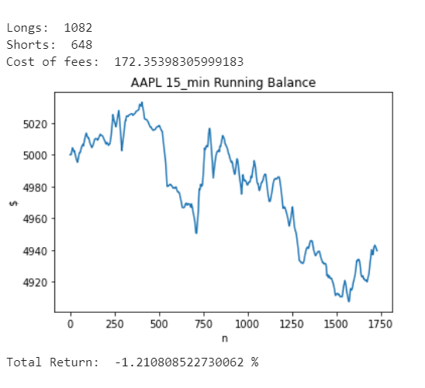
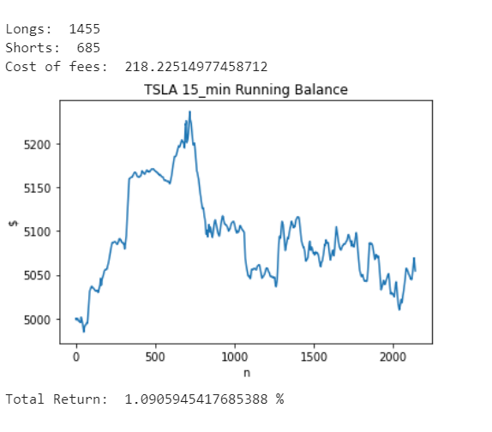
Mac D
Purpose
Initially looked into using this indicator but unfortunately couldn’t get it working
Indicator is based off a 26 day EMA and 12 day EMA that is compared to a signal line
The signal line is calculated by a 9 day EMA of the Mac D line
Looked into as it responds to the speed of price movement well and can tell a trader where the momentum is

Slide 7
Trading Strategy
Explanation
The range in our investment strategy is based on indicators
Algorithm consists of multiple conditions in respect with each separate indicator
The selling and buying conditions are displayed in the diagram below
RSIs > 40
Price > Lower Bollinger
BUY
Price Intersects Support or Resistance
RSIs < 60
Price < Upper Bollinger
SELL

Slide 8
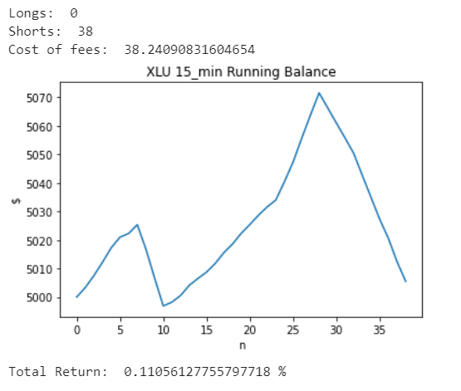
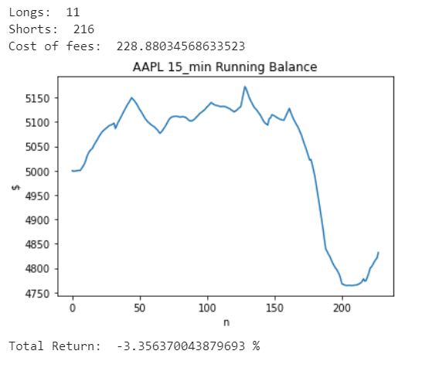
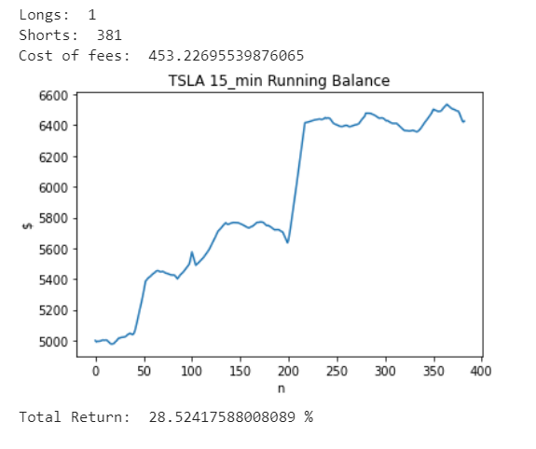
Final Results
Final Parameters
RSI: 40-60, both weekly and daily
MACD: Removed, Algorithm isn’t working properly
Bollinger Bands: 2 Stds from MA of past week
Diagrams of different securities

